Slide 1

Notes:
Opening & Hook:
Welcome, everyone. Today, we are discussing a fundamental shift in how go-to-market (GTM) organizations operate. For the last two decades, software companies scaled sales by dividing up roles into extreme micro-specializations: SDRs, AEs, AMs, and CSMs. Today, we are declaring that the hyper-specialized sales team model is officially broken, giving rise to the Agent-Empowered Full-Cycle Seller.
Context & Background:
These insights are synthesized from The Science of Scaling podcast featuring host Mark Roberge and guest Christopher O'Donnell, founder of Day AI and former Chief Product Officer at HubSpot. Having witnessed the previous generation of MarTech and sales automation, they have spent the last several years re-architecting how revenue organizations will operate in the post-AI era.
Key Takeaway:
This isn't about giving your sales reps a prompt to generate faster cold emails. It’s about leveraging AI agents and a unified customer memory layer to strip away administrative bloat, eliminate broken pipeline handoffs, and empower a single seller to manage the entire customer life cycle end-to-end.
https://www.youtube.com/watch?v=xQkR78msHRU

Slide 2
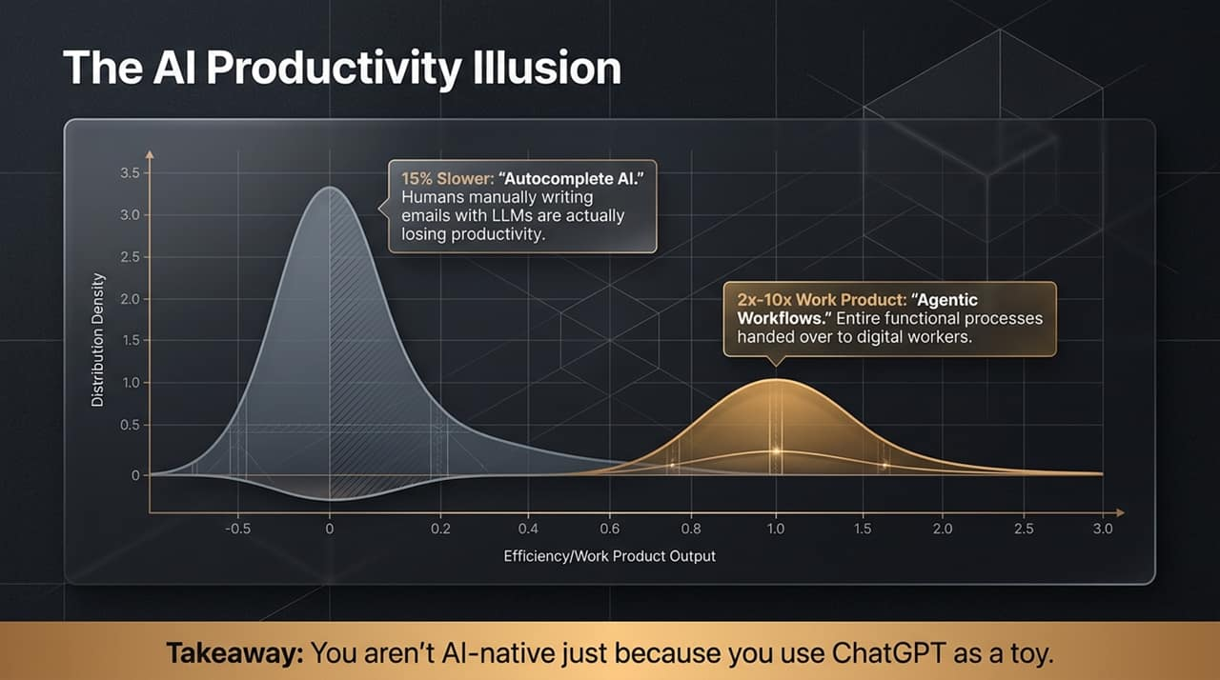
Notes:
The Core Problem / Current State:
Look at this distribution graph. Right now, most companies are trapped in what we call The AI Productivity Illusion. Executive leadership goes into boardrooms boasting about how AI-native their teams are simply because reps use ChatGPT or LLMs to autocomplete emails.
The Bimodal Reality [17:48]:
The Autocomplete Trapped Majority (-15% Efficiency): Research shows that reps who manually use LLMs to write emails or perform simple prompt-response tasks are actually 15% less productive. Why? Because context-switching, prompt tweaking, and copy-pasting take more time than writing the email manually.
The Agentic Workflow Cohort (2x–10x Output): On the right side of the curve, true AI-native organizations hand entire functional processes over to autonomous digital workers. They aren't typing prompts; they are orchestrating workflows.
Speaker Script / Anecdote:
If your AI strategy consists of reps asking ChatGPT to summarize a doc or write a follow-up email, you aren't AI-native—you're just playing with toys. True productivity gains only occur when we shift from point-solution prompts to agentic systems that run in the background.

Slide 3
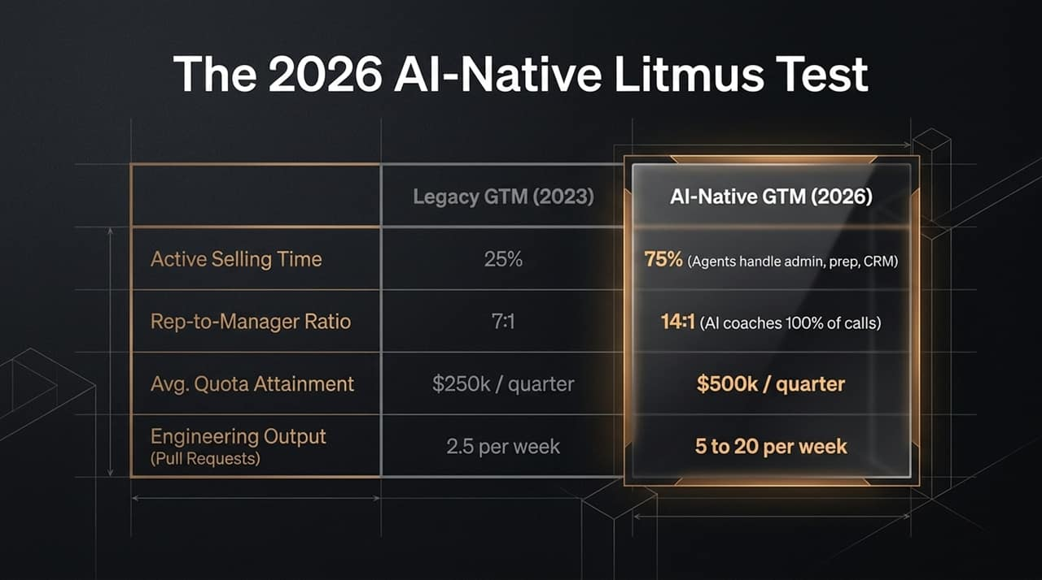
Notes:
Comparing Legacy vs. AI-Native Metrics [18:45]:
To evaluate whether an organization is genuinely AI-native, we look at four key metrics comparing Legacy GTM (2023) against AI-Native GTM (2026):
Active Selling Time (25% → 75%): Historically, sellers spent only 25% of their week actually talking to buyers or closing deals. AI agents assume administrative, CRM entry, and meeting preparation work, tripling active selling time.
Rep-to-Manager Ratio (7:1 → 14:1): Sales managers spend an immense amount of time listening to calls and conducting pipeline reviews. AI coaches evaluate 100% of calls and deliver hyper-personalized coaching based on seller receptivity, allowing manager spans to double.
Average Quota Attainment ($250k → $500k/quarter): Reps transition from barely hitting baseline targets to producing double the revenue output through automated research and pipeline execution.
Engineering Output Parallel (2.5 → 5–20 Pull Requests/week) [16:59]: The average engineer historically pushes 2.5 pull requests per week. AI-native engineering teams achieve 2x to 8x output. Sales organizations must demand the exact same step-function increase.

Slide 4
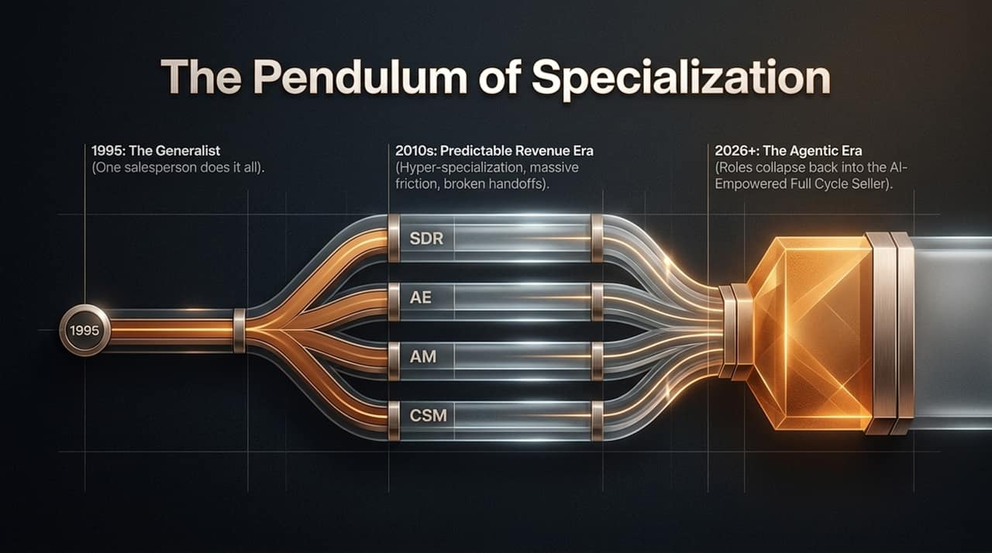
Notes:
Historical Evolutionary Timeline [43:41]:
1995 (The Generalist Era): A single salesperson managed prospecting, pitching, closing, and account maintenance.
2010s (Predictable Revenue Era): Driven by Aaron Ross's Predictable Revenue framework, sales split into extreme hyper-specialization: SDRs for outreach, AEs for closing, AMs for upsells, and CSMs for onboarding.
2026+ (The Agentic Era): The pendulum swings back. Roles collapse back into the AI-Empowered Full-Cycle Seller.
The Problem with Specialization [10:39]:
Hyper-specialization was necessary because human cognitive limits prevented one person from mastering every step of the funnel. However, it introduced severe costs: local maximum optimization, broken handoffs between reps, and a fragmented customer experience.

Slide 5
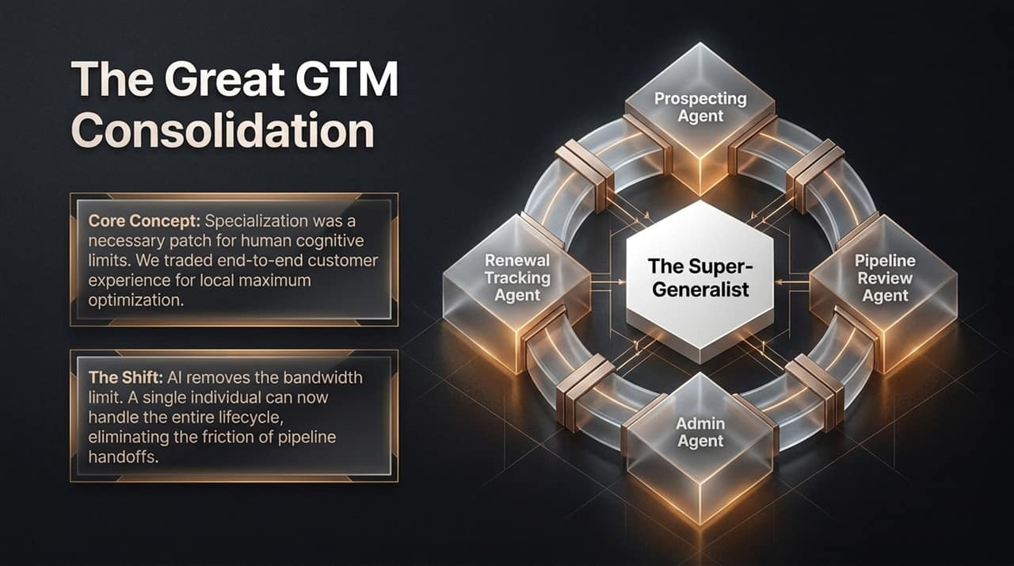
Notes:
Core Concept & Shift [08:10]:
Why do buyers have to endure six different handoffs when evaluating software? Not because they want to, but because our organizational models demanded it. Specialization was a human patch for cognitive limits. AI eliminates that bandwidth ceiling.
Anatomy of the Super-Generalist:
Instead of four separate people handling a account, one Super-Generalist manages the entire buyer relationship. Surrounding this generalist is a team of specialized AI agents:
Prospecting Agent: Continuously discovers ideal customer patterns and drafts warm outreach.
Admin Agent: Automates scheduling, follow-ups, and CRM updates.
Pipeline Review Agent: Analyzes deal health and alerts the seller to missing buying signals.
Renewal Tracking Agent: Tracks customer usage trends and identifies expansion opportunities.
Result:
The customer experiences a seamless, single-point-of-contact relationship from discovery to expansion.

Slide 6
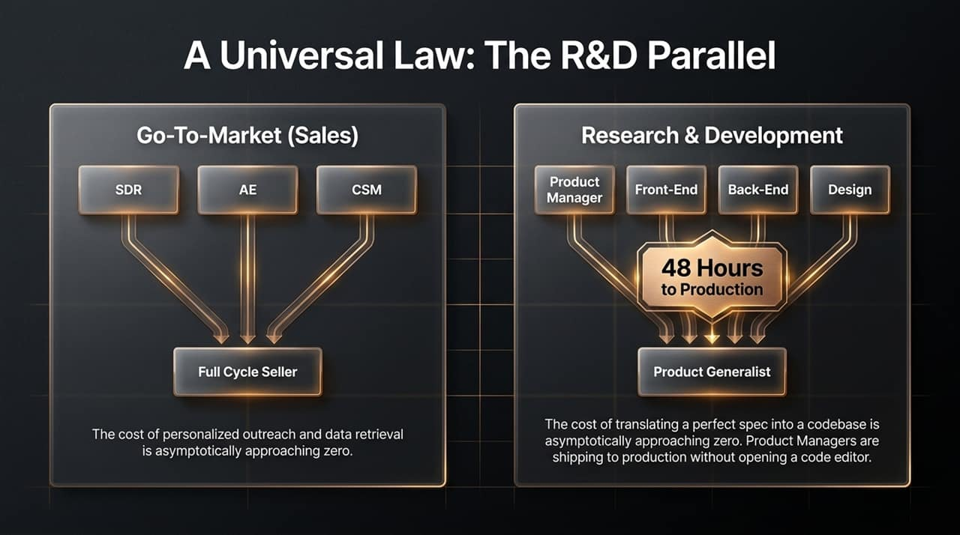
Notes:
The Parallel Between Sales and Engineering [09:46]:
This role collapse is not isolated to sales; it is a universal law taking place across R&D as well.
R&D Transformation [44:54]: In R&D, roles expanded into Product Managers, Designers, Front-End, Back-End, Data Scientists, and QA. Today, the cost of translating a clear spec into functional code is asymptotically approaching zero. Product Managers now ship production-ready code via agentic coding tools like Claude Code without opening a traditional code editor.
GTM Transformation [10:13]: In Sales, the cost of personalized outreach, preliminary research, and data retrieval is asymptotically approaching zero. As a result, SDR, AE, and CSM roles are collapsing into the Full-Cycle Seller.

Slide 7
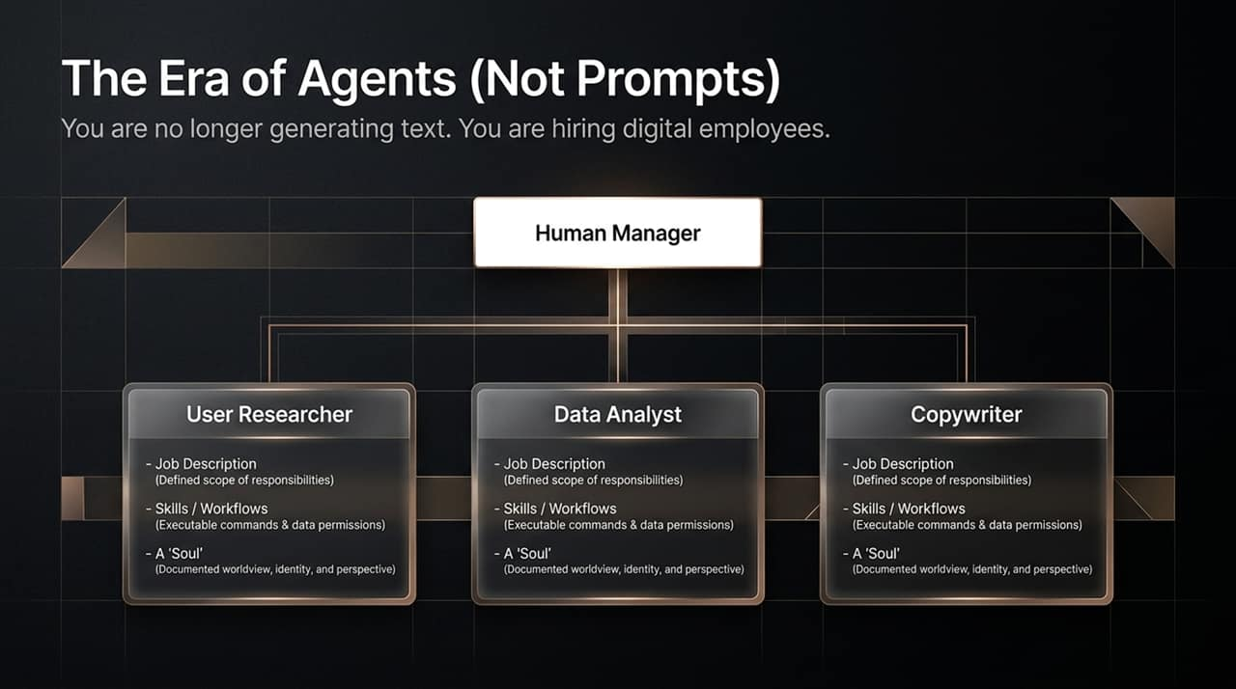
Notes:
From Prompts to Digital Employees [13:34]:
Stop thinking about AI as prompt engineering. In the Agentic Era, you do not write prompts—you hire digital employees.
The Three Components of an AI Agent [13:43]:
To deploy an effective AI agent (whether a User Researcher, Data Analyst, or Copywriter), you must define three core artifacts:
Job Description: A clear scope of responsibilities and goals.
Skills & Workflows: Executable commands, slash triggers, and data permissions.
A Soul / Perspective [14:14]: A documented worldview, brand tone, identity, and set of operating opinions that dictate how the agent makes decisions.
Actionable Advice [05:54]:
Take your current role, split off 1 to 5 task areas you dislike doing, write clear job descriptions for them, and hand them to autonomous AI agents.

Slide 8
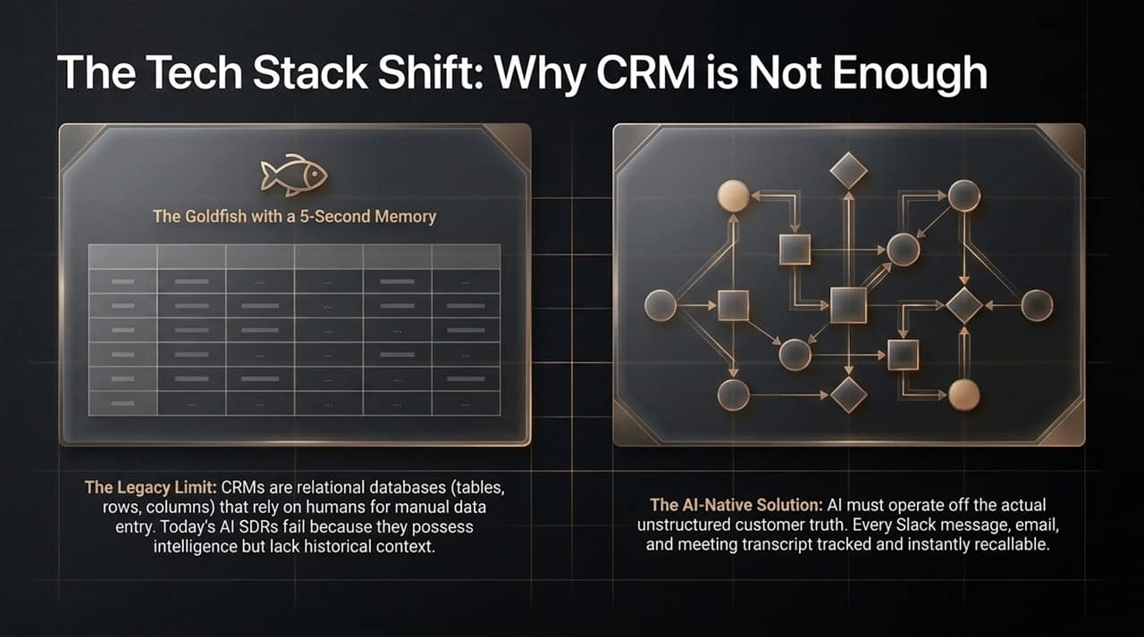
Notes:
The CRM Limit (The Goldfish Memory) [15:42]:
Legacy CRMs are structured relational databases (tables, rows, and columns) designed for manual human data entry. Because human data entry is sparse and inconsistent, CRMs act like a goldfish with a 5-second memory. Today's AI SDR tools fail not because the models lack intelligence, but because they lack unstructured historical context.
The AI-Native Solution [16:04]:
AI agents cannot operate on rigid CRM fields alone. They require the actual unstructured customer truth—capturing every raw Slack message, email thread, meeting transcript, and document instantly.

Slide 9
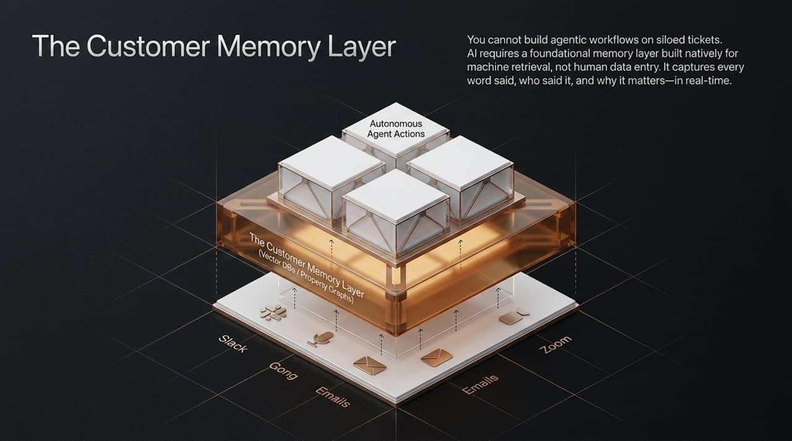
Notes:
Technical Architecture [26:34]:
To power autonomous agent actions, companies must replace or augment traditional CRMs with a Customer Memory Layer built on Vector Databases and Property Graphs.
How It Functions [16:04]:
Ingestion: Ingests ambient data streams from Slack, Gong, Zoom, and Email in real-time.
Storage & Context: Captures every spoken and written word, identifying who said it, the emotional context, and why it matters.
Machine Retrieval [38:29]: Provides AI agents with instantaneous, full-context retrieval before executing actions (e.g., generating tailored pipeline outreach or preparing meeting briefing docs).

Slide 10
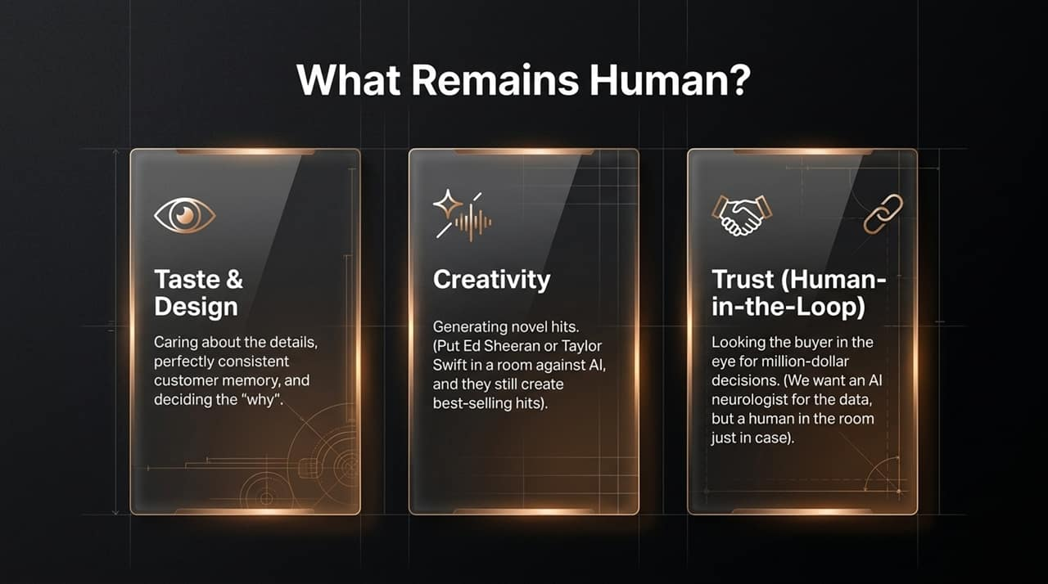
Notes:
The Three Human Pillars [03:00]:
If AI handles prospecting, admin, data synthesis, and routine communication, what is the role of the human seller?
Taste & Design [03:06]: Meticulous attention to detail, brand voice, deciding the strategic why, and ensuring absolute quality across customer touchpoints.
Creativity [04:22]: Generating truly novel ideas. As Mark Roberge noted: Put Ed Sheeran or Taylor Swift in a room against AI, and they will still write best-selling hits.
Trust & Human-in-the-Loop [04:48]: When a buyer makes a million-dollar decision, they require human accountability. Just as patients want a human surgeon in the room alongside an AI diagnostic tool, high-stakes enterprise software buyers need a trusted human seller to look them in the eye and guarantee delivery.

Slide 11
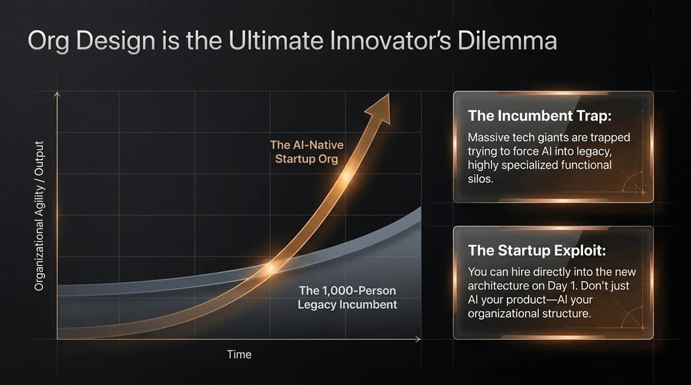
Notes:
The Incumbent Trap vs. The Startup Exploit [40:03]:
The Incumbent Trap [41:21]: Enterprise giants with 1,000-person sales organizations are trapped trying to retrofit AI into highly specialized functional silos (SDR teams, AE teams, CSM teams). Restructuring requires costly retraining or mass layoffs.
The Startup Exploit [41:31]: Startups have a massive structural advantage. They can hire directly into the AI-native, full-cycle model on Day 1.
Key Takeaway [40:51]:
Don't just AI your software product—AI your organizational structure. Org design is the most underutilized lever to out-pace established incumbents.

Slide 12
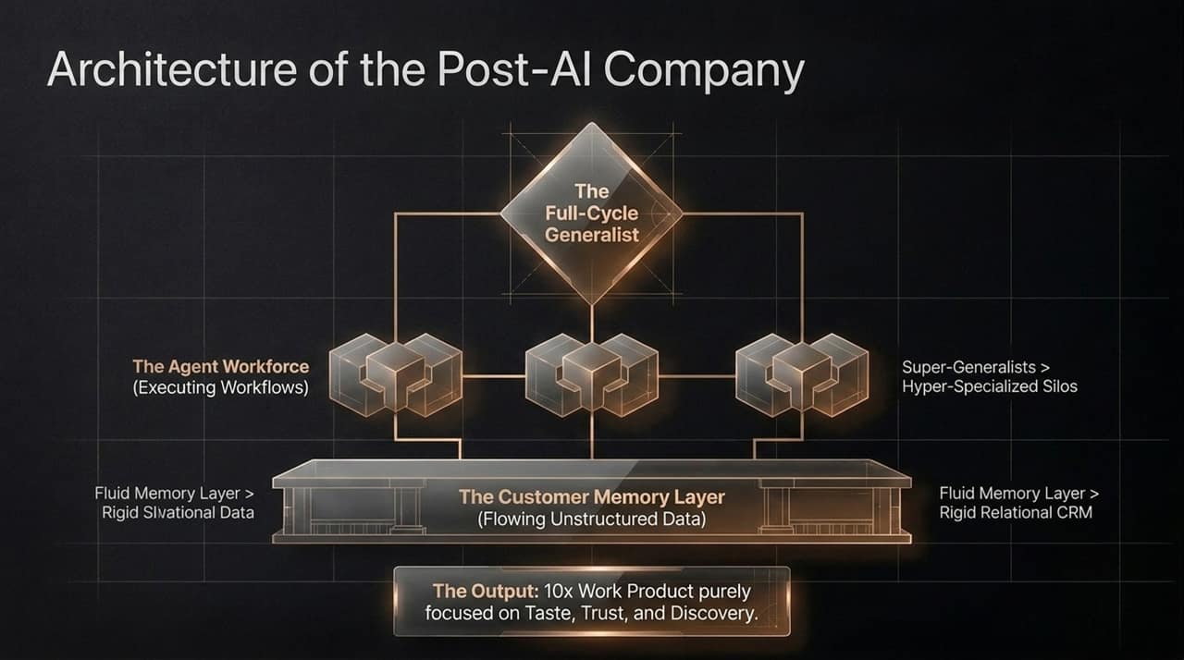
Notes:
End-State Operating Model [10:56]:
Slide 12 brings all the concepts together into a clean, modern organizational blueprint:
Top Layer: The Full-Cycle Generalist focused purely on High-Taste, Trust-building, and Discovery.
Middle Layer: The Agent Workforce executing automated workflows (prospecting, account reviews, renewal tracking).
Bottom Layer: The Fluid Customer Memory Layer capturing real-time unstructured data streams.
Core Principles:
Super-Generalists > Hyper-Specialized Silos.
Fluid Memory Layer > Rigid Relational CRM.
Output: A 10x increase in work product quality and speed.

Slide 13
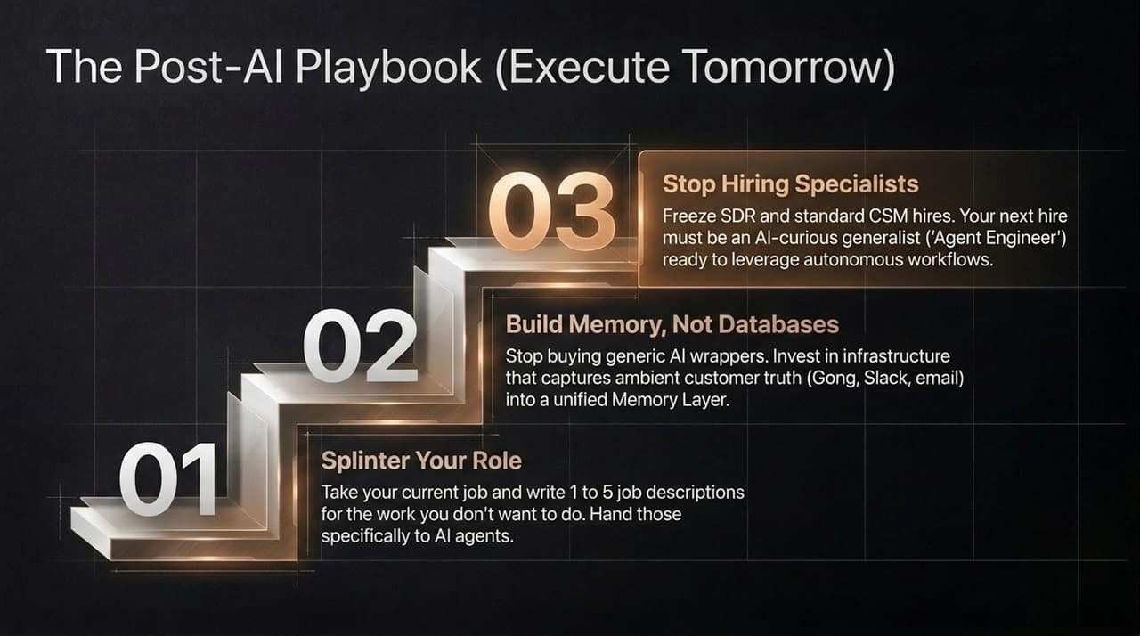
Notes:
Three-Step Actionable Roadmap [05:54]:
Step 01: Splinter Your Role [06:00]: Have every team member write 1 to 5 job descriptions for the administrative or repetitive tasks they want to offload, and assign those roles directly to AI agents.
Step 02: Build Memory, Not Databases [26:34]: Stop buying generic AI point-solution wrappers. Invest in an infrastructure that streams raw ambient communication (Gong, Slack, email) into a unified Customer Memory Layer.
Step 03: Stop Hiring Specialists [51:11]: Freeze traditional SDR and CSM hires immediately. Your next hire should be an AI-curious generalist—an Agent Engineer—who can leverage autonomous workflows and comfortably span the full sales lifecycle.

Slide 14
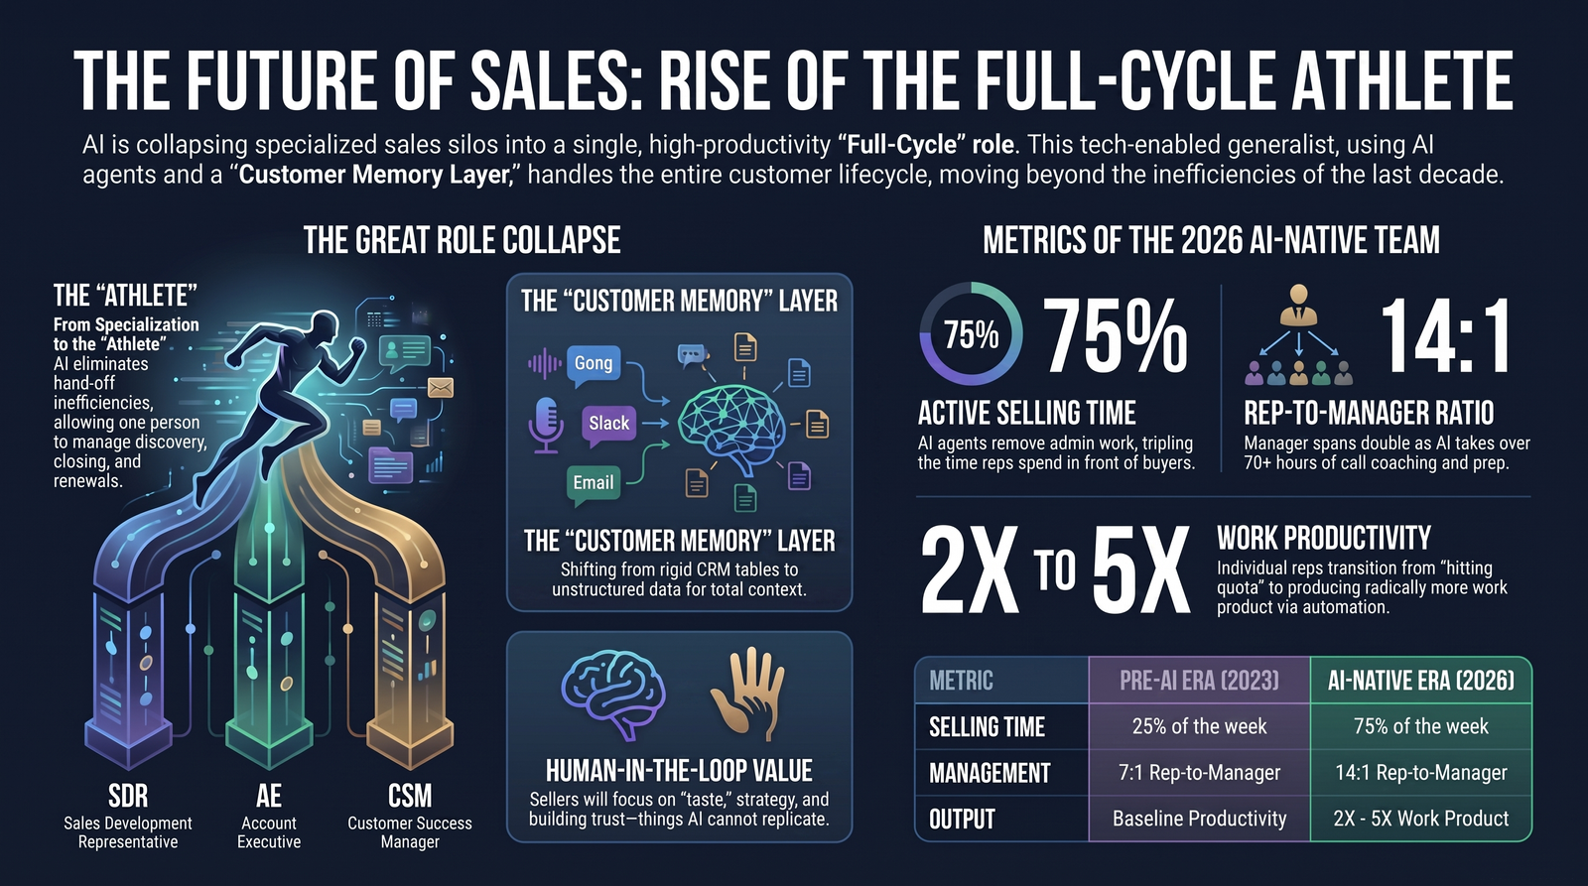
Notes:
Executive Summary & Wrap-Up:
To wrap up, AI is collapsing specialized sales silos into a single, high-productivity role: The Full-Cycle Athlete.
Summary Metrics Table [18:45]:
Selling Time: Increases from 25% to 75% of the work week.
Management Span: Increases from 7:1 to 14:1.
Output: Achieves 2X to 5X total work product output per person.
Final Closing Statement:
By combining high-taste human relationship building with autonomous AI agents and a deep Customer Memory Layer, sales teams can stop drowning in admin work and return to what matters most: human connection, customer trust, and closing deals.

